Slide 1

Chapter 2: Analyzing the Business Case
Nirmal Chakraborty
Version 2 – 18th December 2015

Slide 2

Prescribed Text and recommended readings
Rosenblatt, H. J. (2016), Systems Analysis and Design.11th Edition, Cengage Learning, Boston MA
Robertson, S. and Robertson, J. (2013), Mastering the Requirements Process: Getting Requirements Right, 3rd Edition, Addison Wesley, Upper Saddle River, NJ
IIBA (2015), Guide to the Business Analysis Body of Knowledge, BABOK Version 3.0, International Institute of Business Analysis, http://www.iiba.org/BABOKGuide.aspx

Slide 3
Chapter Objectives
Explain the concept of a business case and how a business case affects an IT project
Describe the strategic planning process and why it is important to the IT team
Explain the purpose of a mission statement
Conduct a SWOT analysis and describe the four factors involved
Explain how the SDLC serves as a framework for systems development

Slide 4
Chapter Objectives
List reasons for systems projects and factors that affect such projects
Describe systems requests and the role of the systems review committee
Define operational, technical, economic, and schedule feasibility
Explain the factors that affect project priorities
Describe the steps and the end product of a preliminary investigation

Slide 5
Introduction
Business case: Justification for a proposal
Requires consideration of the organization’s:
Overall mission
Objectives
IT needs
Systems development process
Systems request
Preliminary investigation
Findings are submitted to management

Slide 6
A Framework for IT Systems Development
Strategic Planning Overview
Strategic planning: Process of identifying long-term organizational goals, strategies, and resources
Starts with a mission statement
Must reflect the firm’s vision, purpose, and values
Critical success factor: High-priority objective
What Is SWOT Analysis?
Strengths, weaknesses, opportunities, and threats
Examines a firm’s technical, human, and financial resources

Slide 7
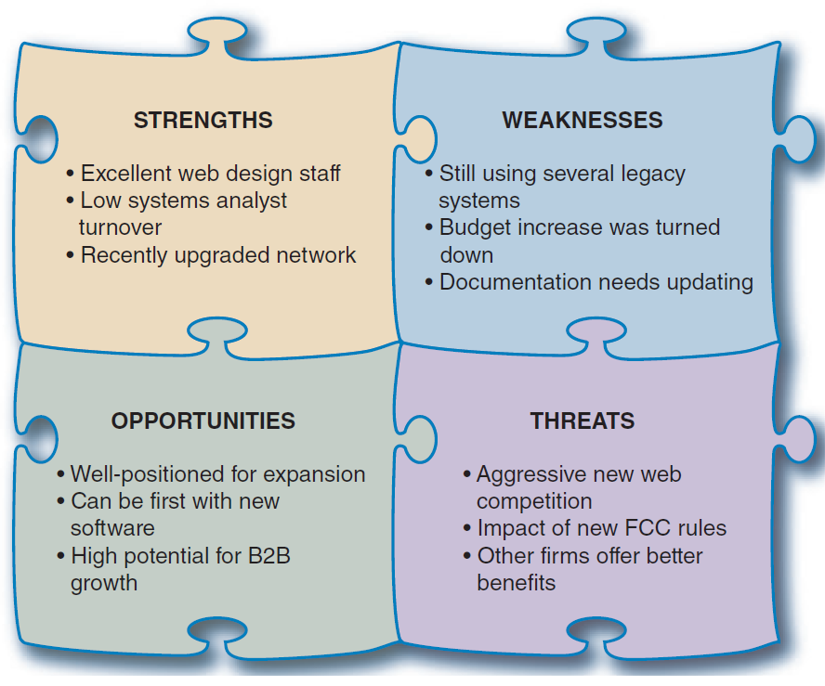
A Framework for IT Systems Development
FIGURE 2-1 A SWOT analysis might produce results similar to those
shown here.

Slide 8
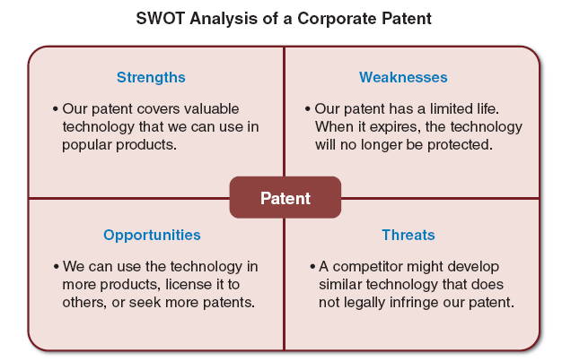
A Framework for IT Systems Development
FIGURE 2-2 This SWOT analysis example focuses on a specific asset, such as a company patent.

Slide 9
A Framework for IT Systems Development
Strategic Planning for IT Projects
Careful planning can help assure that:
The project supports overall business strategy and operational needs
The project scope is well-defined and clearly stated
The project goals are realistic, and tied to specific statements, assumptions, constraints, factors, and other inputs
Planning tools
Microsoft Word and Excel
CASE tools
Visible Analyst

Slide 10
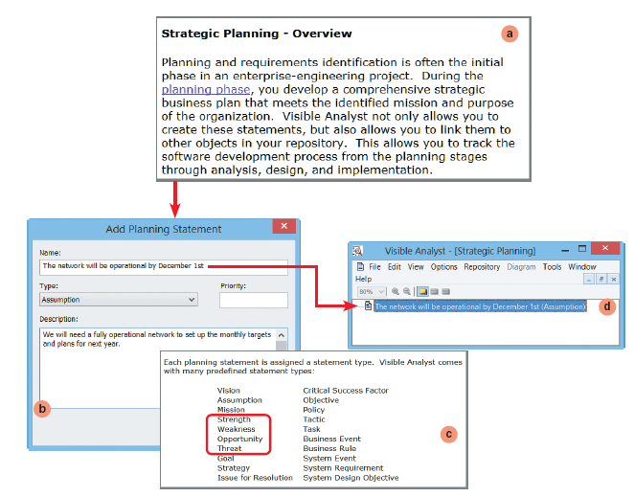
A Framework for IT Systems Development
FIGURE 2-3 The Visible Analyst CASE tool supports strategic planning and allows a user to enter many kinds of planning statements. Notice the four SWOT categories highlighted in the list.
Screenshots used with permission from Visible Systems Corporation.

Slide 11
A Framework for IT Systems Development
The Changing Role of the IT Department
Management and IT are linked closely
Remarkable changes have occurred in both areas
Today, systems development is much more team- oriented
The IT department is responsible for screening and evaluating systems requests
Larger firms may use an evaluation team or systems review committee

Slide 12
What Is a Business Case?
A business case should:
Be comprehensive and easy to understand
Describe the project clearly, provide the justification to proceed, and estimate the project’s financial impact
Questions answered by a business case
Why are we doing this project?
How much will it cost and how long will it take?
Are there any risks involved?
How will we measure success?
What alternatives exist?

Slide 13
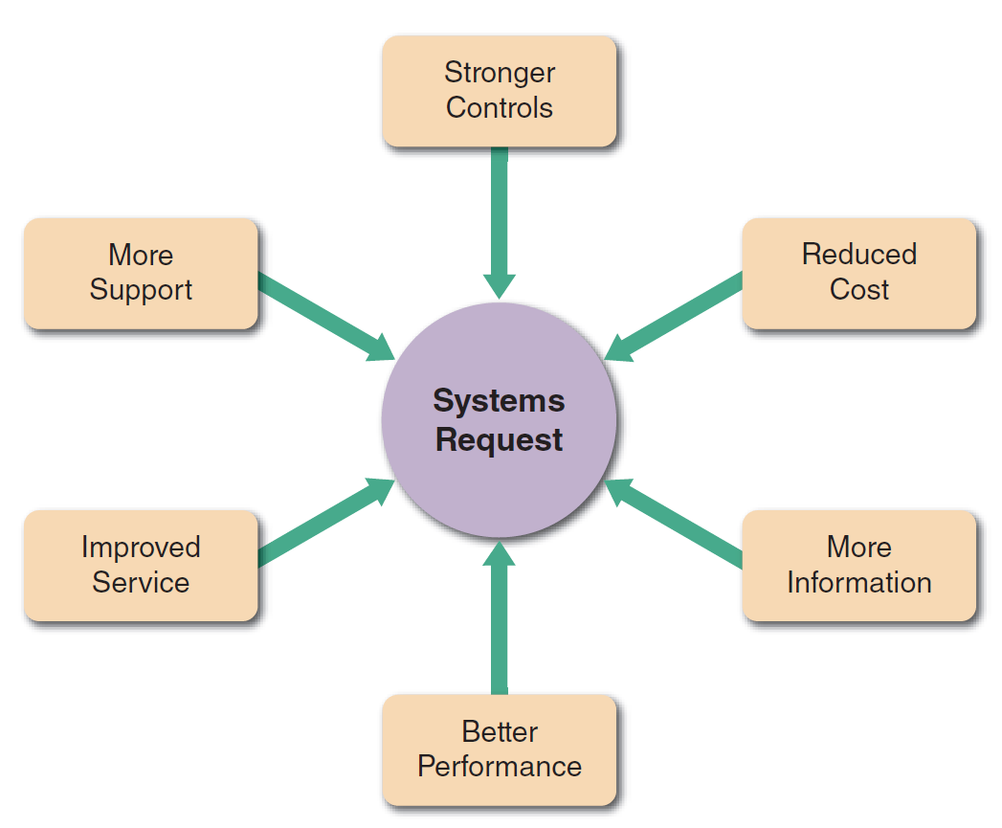
Information Systems Projects
Stronger Controls: Data is secure and accurate. Common security controls – passwords, access control, encryption.
Reduced Cost: Cost benefit analysis must show cost effective for long term objectives.
More Info: Information may insufficient, incomplete.
Better Performance: Current system may not meet satisfactory performance requirements.
Improved services: to meet customer or user satisfaction.
More support: a software vendor may offer an automatic upgrade, a package delivery company
FIGURE 2-4 Six main reasons for systems requests.

Slide 14
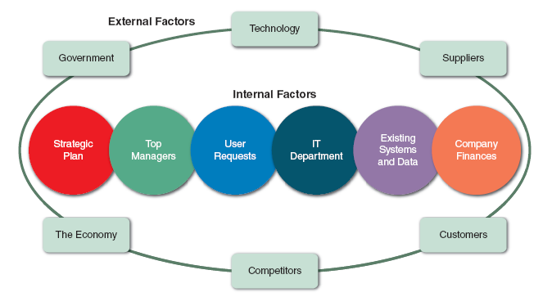
Information Systems Projects
FIGURE 2-6 Internal and external factors that affect IT projects.

Slide 15
Evaluation of Systems Requirements
Systems requests are evaluated by a systems review committee or a computer resources committee
Systems Request Forms
Streamline the request process
Ensure consistency
Easy to understand
Include clear instructions
Indicate the required supporting documents
Submitted electronically

Slide 16
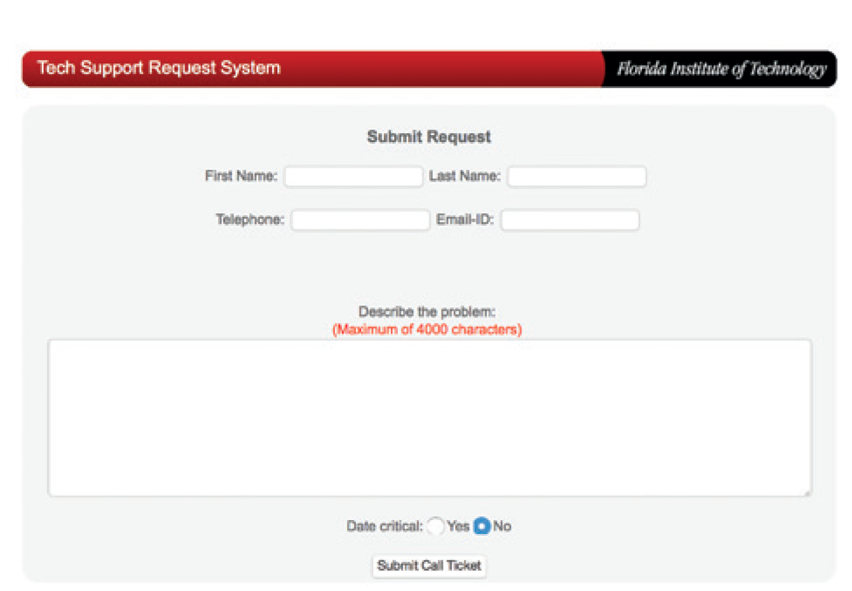
Evaluation of Systems Requirements
FIGURE 2-10 Example of an online systems request form.
Source: Florida Institute of Technology

Slide 17
Evaluation of Systems Requirements
Systems Review Committee
A broader viewpoint enables a committee to establish priorities more effectively than an individual
One person’s bias is less likely to affect decisions
Disadvantages
Action on requests must wait until the committee meets
Members might favor projects requested by their own departments
Internal political differences could delay important decisions

Slide 18
Overview of Feasibility
Feasibility studies can be simple or exhaustive
Effort required depends on the nature of the request
Initial fact-finding involves:
Studying organizational charts
Performing interviews
Reviewing current documentation
Observing operations
Surveying users

Slide 19
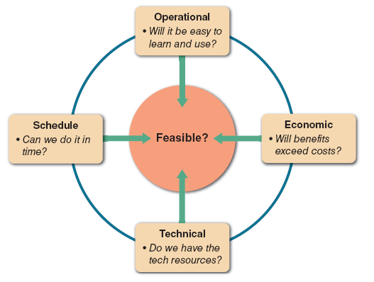
Overview of Feasibility
FIGURE 2-11 A feasibility study examines operational, technical, economic, and schedule factors.

Slide 20
Overview of Feasibility
Operational Feasibility
A proposed system will be used effectively after it has been developed
Can be affected by organizational culture
Cannot be accurately measured but requires careful study
Questions that can help predict a system’s operational feasibility
Is the project supported by management and users?
Will the new system result in a workforce reduction?
Do legal or ethical issues need to be considered?

Slide 21
Overview of Feasibility
Economic Feasibility
Projected benefits of a proposed system out-weigh total cost of ownership (TCO)
Determination of TCO requires cost analysis of:
People, including IT staff and users
Hardware and equipment
Software
Formal and informal training
Licenses and fees
Consulting expenses
Facility costs

Slide 22
Overview of Feasibility
Tangible costs are measured in dollars
Intangible costs can significantly affect organizational performance
Tangible benefits can result from a decrease in expenses or an increase in revenues
Intangible benefits are important to the company despite the inability to measure them in dollars

Slide 23
Overview of Feasibility
Technical Feasibility
Technical resources required to acquire and use the system
Questions analysts should ask
Does the company have the necessary hardware, software, and network resources?
Does the company have the required technical expertise?
Does the proposed platform have sufficient capacity for future needs?
Will a prototype be required?

Slide 24
Overview of Feasibility
Schedule Feasibility
A project can be implemented in an acceptable time frame
Issues that can affect schedule feasibility
Interaction between time and costs
Can the company or the IT team control the factors that affect schedule feasibility?
Has management established a firm timetable for the project?
What conditions must be satisfied during the development of the system?
Will an accelerated schedule pose any risks?

Slide 25
Evaluating Feasibility
Identify and weed out systems requests that are not feasible
Some feasible requests may not be necessary
Requests that are not currently feasible can be resubmitted as new hardware, software, or expertise becomes available

Slide 26
Setting Priorities
Factors that Affect Priority
Will the proposed system reduce costs?
Will the system increase revenue for the company?
Will the systems project result in more information or produce better results?
Will the system serve customers better?
Will the system serve the organization better?
Can the project be implemented in a reasonable time period?
Are the necessary financial, human, and technical resources available?

Slide 27
Setting Priorities
Discretionary and Nondiscretionary Projects
Discretionary projects: Projects where management has a choice in implementing them
Nondiscretionary projects: Management has no choice in implementing a project
Most of these projects are predictable
Annual updates to payroll
Tax percentages
Quarterly changes

Slide 28
Preliminary Investigation Overview
Interaction with Managers and Users
Meet with key managers, users, and IT staff to describe the project, explain responsibilities, answer questions, and invite comments
Focus on improvements and enhancements, not problems

Slide 29
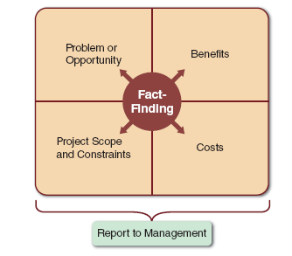
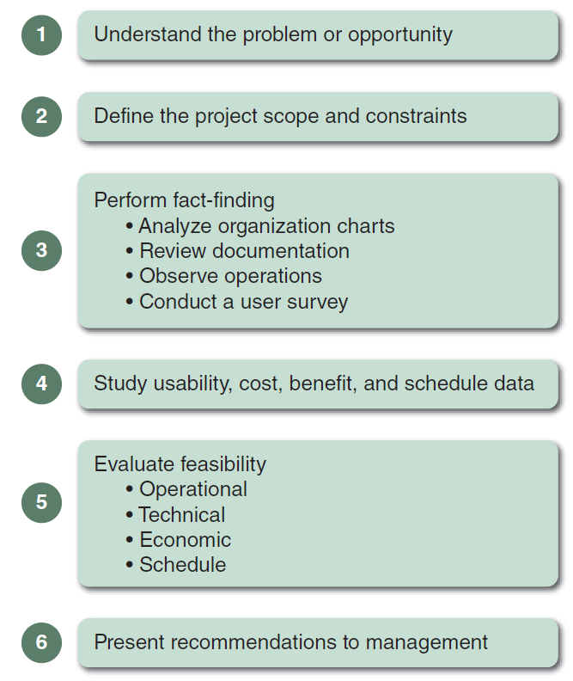
Preliminary Investigation Overview
FIGURE 2-12 Model of a preliminary investigation. Notice the importance of fact-finding in each of the four areas.
FIGURE 2-13 Six main steps in a typical preliminary investigation.

Slide 30
Preliminary Investigation Overview
Planning the Preliminary Investigation
Step 1- Understand the problem or opportunity
Develop a business profile that describes current business processes and functions
Understand how modifications will affect business operations and other information systems
Identify the departments, users, and business processes involved
Consider using a fishbone diagram

Slide 31
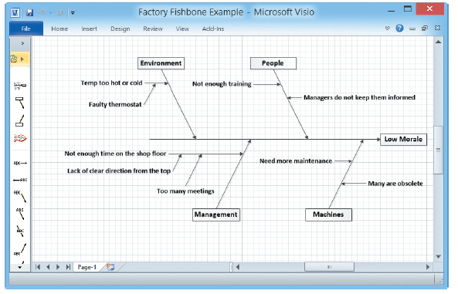
Preliminary Investigation Overview
FIGURE 2-14 A fishbone diagram displays the causes of a problem. Typically, you must dig deeper to identify actual causes rather than just symptoms.

Slide 32
Preliminary Investigation Overview
Planning the Preliminary Investigation (Cont.)
Step 2 - Define the project scope and constraints
Define the specific boundaries, or extent, of the project
Define project scope by creating a list with sections called must do, should do, could do, and won’t do
Avoid project creep
Project creep: Process by which projects with very general scope definitions expand gradually, without specific authorization
Identify constraints
Constraint: A requirement or condition that the system must satisfy or an outcome that the system must achieve

Slide 33
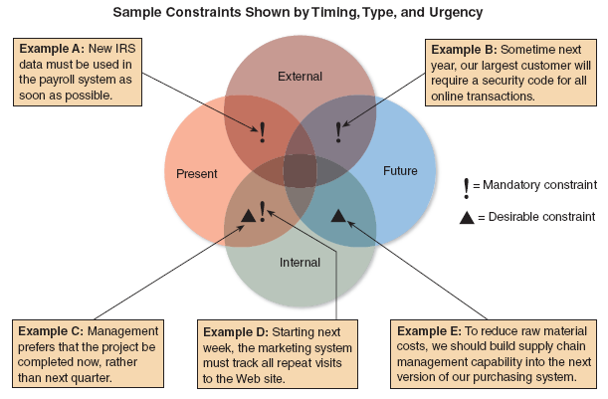
Preliminary Investigation Overview
Internal Revenue Service
FIGURE 2-15 Examples of various types of constraints.

Slide 34
Preliminary Investigation Overview
Planning the Preliminary Investigation (Cont.)
Step 3 - Perform fact-finding
Gather data about project usability, costs, benefits, and schedules
Analyze organization charts, conduct interviews, review documentation, observe operations, and conduct a user survey
Analyze the data
Pareto chart
XY chart (scatter diagram)

Slide 35
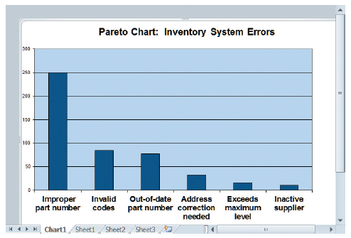
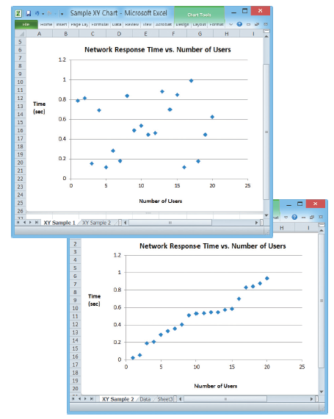
Preliminary Investigation Overview
FIGURE 2-17 A Pareto chart displays the causes of a problem, in priority order, so an analyst can tackle the most important causes first. In this example, the part number issue would be the obvious starting point.
FIGURE 2-18 An XY chart shows correlation between variables, which is very important in problem solving. Conversely, a lack of correlation suggests that the variables are independent, and that you should look elsewhere for the cause.

Slide 36
Preliminary Investigation Overview
Planning the Preliminary Investigation (Cont.)
Step 4 - Analyze project usability, cost, benefit, and schedule data
Factors to consider
What information must be obtained, and how will it be gathered and analyzed?
Who will conduct the interviews? How many people will be interviewed?
Will a survey be conducted? Who will be involved? How much time will it take to tabulate the results?
How much will it cost to analyze the information and prepare a report with findings and recommendations?

Slide 37
Preliminary Investigation Overview
Planning the Preliminary Investigation (Cont.)
Step 5 - Evaluate feasibility
Operational feasibility
Technical feasibility
Economic feasibility
Schedule feasibility
Step 6 - Present results and recommendations to management
Prepare a report that includes:
An evaluation of the systems request
An estimate of costs and benefits
A case for action

Slide 38
Preliminary Investigation Overview
Planning the Preliminary Investigation (Cont.)
Format of a report
Introduction
Systems request summary
Findings
Recommendations
Project roles
Time and costs estimates
Expected benefits
Appendix

Slide 39
Chapter Summary
Systems planning is the first phase of the systems development life cycle
A business case should:
Describe the project clearly
Provide the justification to proceed
Estimate the project’s financial impact

Slide 40
Chapter Summary
Factors that affect systems projects:
User requests
top management directives
existing systems
the IT department
software and hardware vendors
technology, customers
Competitors
the economy, and
government

Slide 41
Chapter Summary
Analysts evaluate the systems request and determine whether the project is feasible from an operational, technical, economic, and schedule standpoint
Steps in the preliminary investigation:
Understand the problem or opportunity
Define the project scope and constraints
Perform fact-finding and analyze project usability, cost, benefit, and schedule data
Evaluate feasibility and present results and recommendations to management

Slide 42

kent.edu.au Kent Institute Australia Pty. Ltd. ABN 49 003 577 302 ● CRICOS Code: 00161E ● RTO Code: 90458 ● TEQSA Provider Number: PRV12051

